Slide 1
Support Vector Machine
Most.Kaniz Fatema Isha
Lecturer, CSE,
KUET

Slide 2
Introduction
Support Vector Machines (SVMs) are machine learning algorithms that are used for classification and regression purposes.
SVMs are one of the powerful machine learning algorithms for classification, regression and outlier detection purposes.
An SVM classifier builds a model that assigns new data points to one of the given categories. Thus, it can be viewed as a non-probabilistic binary linear classifier.

Slide 3
SVMs can be used for linear classification purposes.
In addition to performing linear classification, SVMs can efficiently perform a non-linear classification using the kernel trick.It enable us to implicitly map the inputs into high dimensional feature spaces.

Slide 4
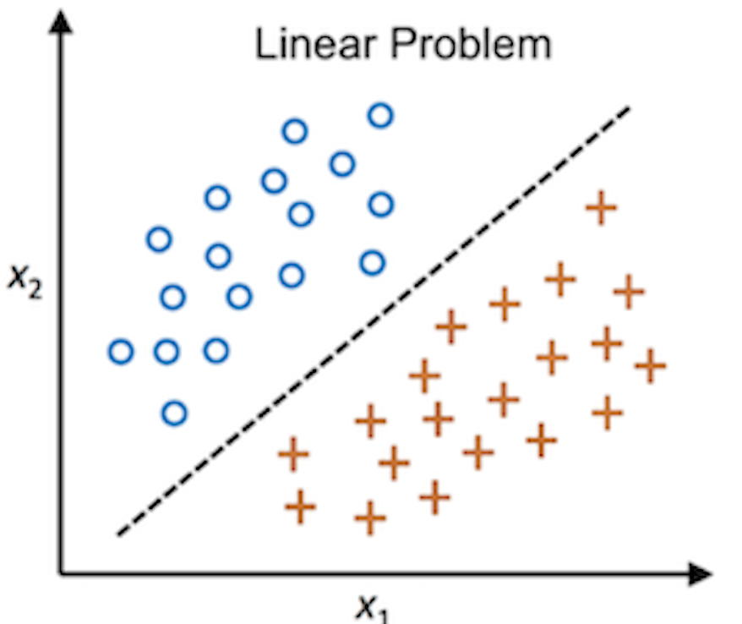
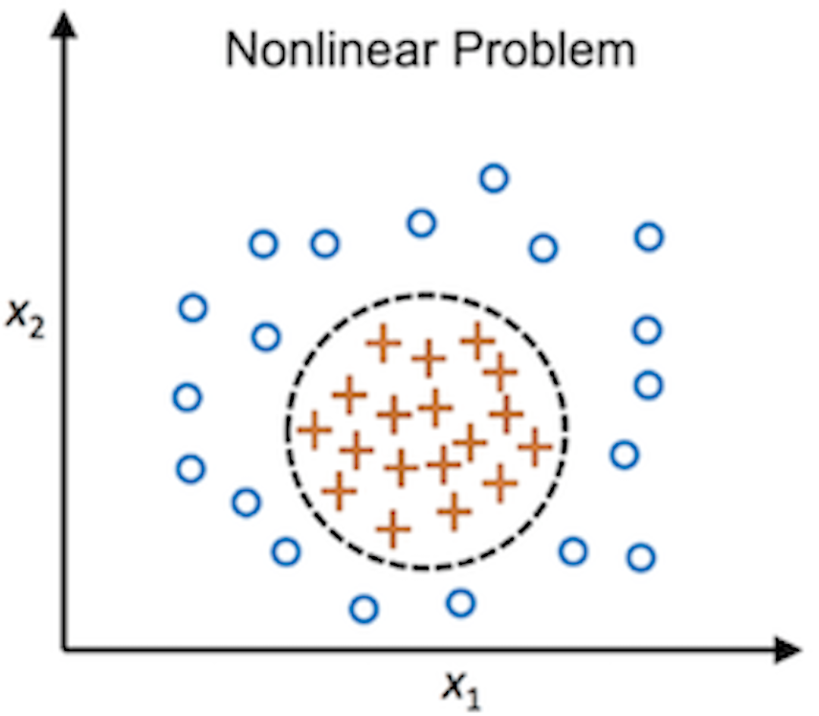

Slide 5
Introduction
How to place the classifier?

Slide 6
Introduction
How to place the classifier?

Slide 7
Introduction
How to place the classifier?
Maximal Margin Classifier

Slide 8
However, Maximal Margin Classifier are highly sensitive to outliers and often not suitable for real world data.
That is why we opt for using Soft Margin Classifier.

Slide 9
Introduction
How to place the classifier?

Slide 10
Introduction
How to place the classifier?
Miss Classification
Soft Margin Classifier

Slide 11
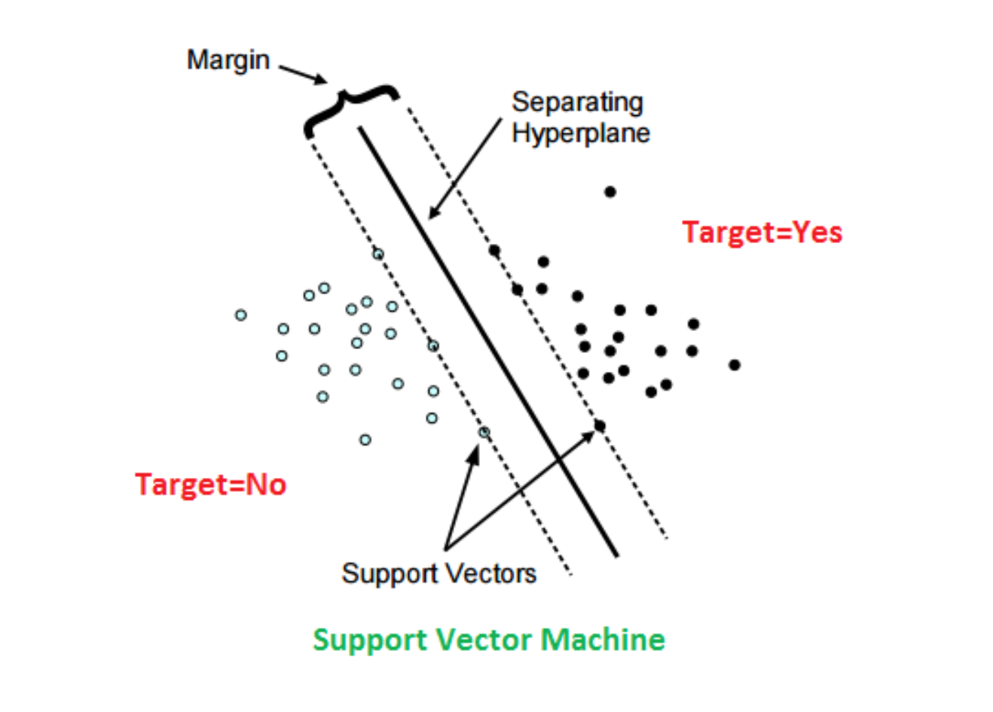

Slide 12
Key Concepts in SVM
Hyperplane: A decision boundary that separates data points of different classes. The SVM finds the maximum margin hyperplane, which ensures the widest separation between classes.
Support Vectors: The closest data points to the hyperplane. They define the hyperplane and influence the margin.
Margin: The perpendicular distance between the hyperplane and the support vectors. SVM maximizes this margin to achieve the best separation.

Slide 13
SVM Objective: Maximum Margin Hyperplane
Hyperplane Selection:SVM identifies hyperplanes that segregate the classes.The goal is to find the best hyperplane with the largest separation (margin) between classes.
Maximizing the Margin:The optimal hyperplane ensures the maximum distance from the support vectors on both sides.This hyperplane is called the maximum margin hyperplane, and the classifier it defines is the maximum margin classifier.

Slide 14
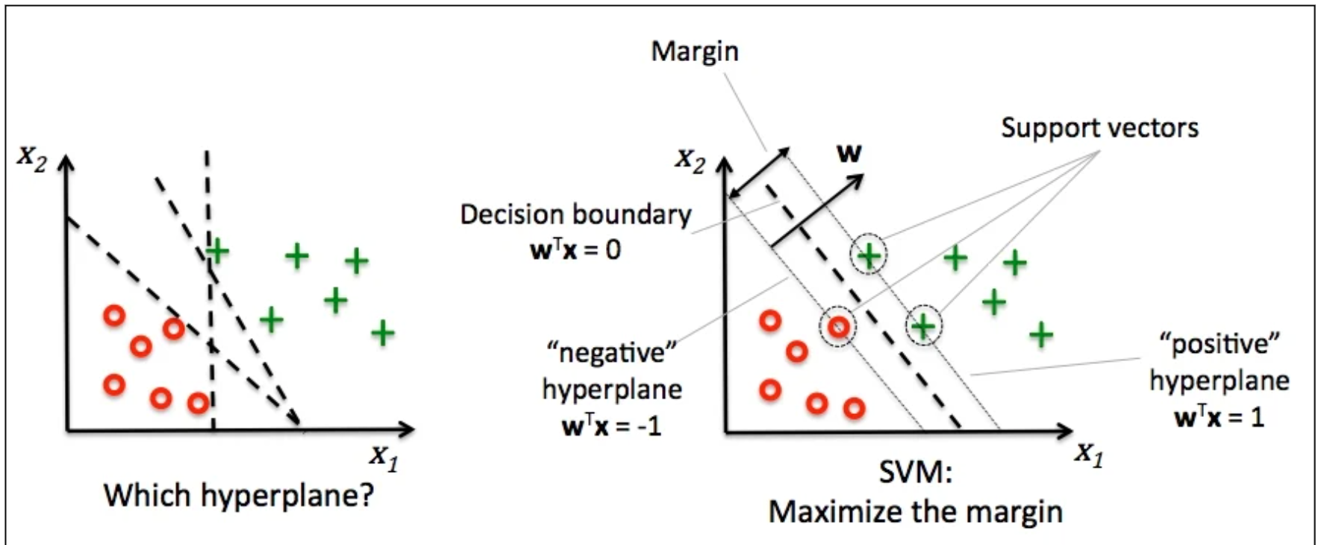
Key Concepts in SVM

Slide 15
SVM Tuning Parameters
Kernels
Regularization
Gamma

Slide 16
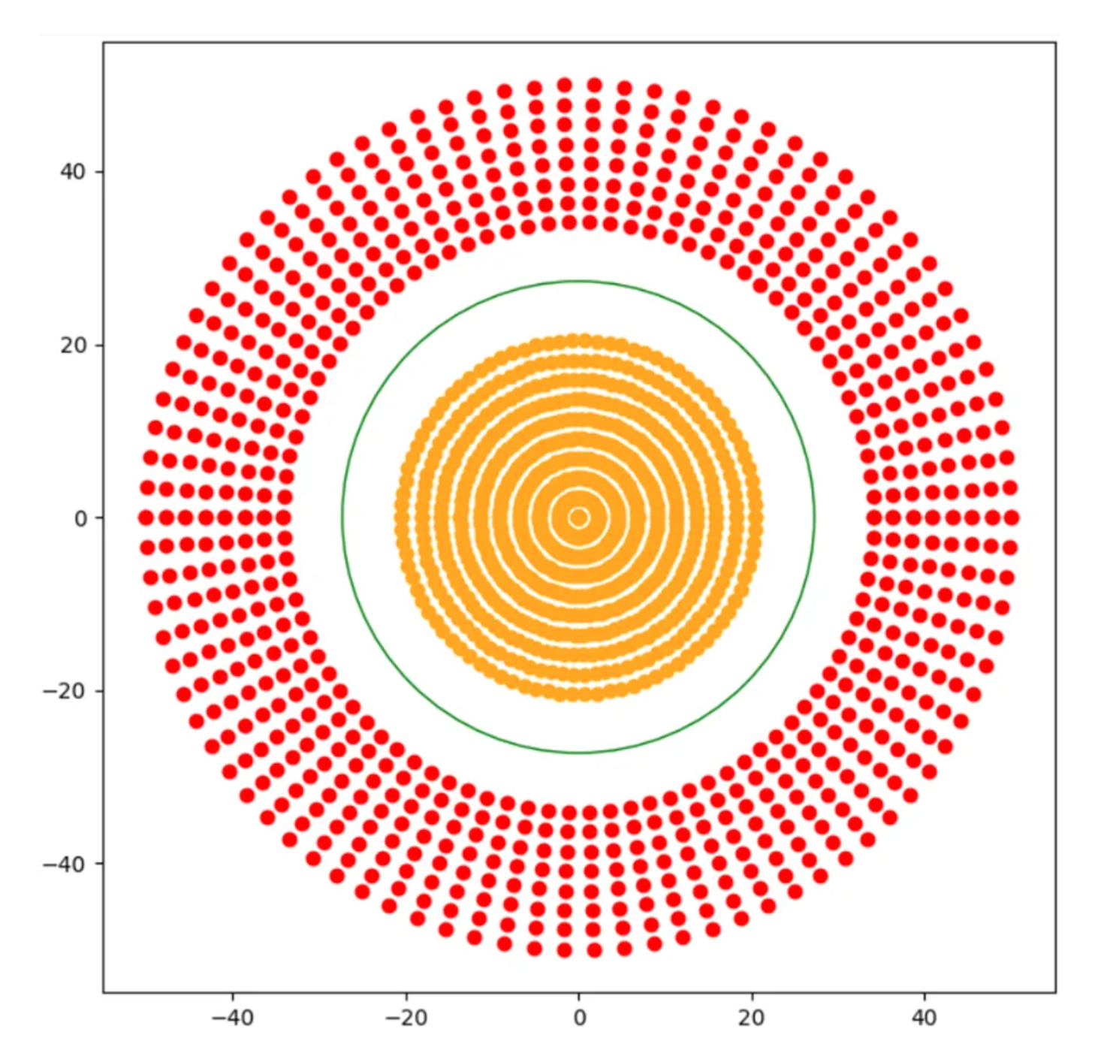
What happens when the data is not linearly separable?

Slide 17
What happens when the data is not linearly separable?

Slide 18
Kernel Trick
SVM applies the kernel trick to transform the input space into a higher-dimensional space.
This transformation (e.g., from 2D to 3D) makes it possible to separate data points linearly in the new space.
Kernel functions systematically find support vector classifier in higher dimensions.
However, this technique doesnt actually transform the data, rather find the similarity of points through some function.

Slide 19
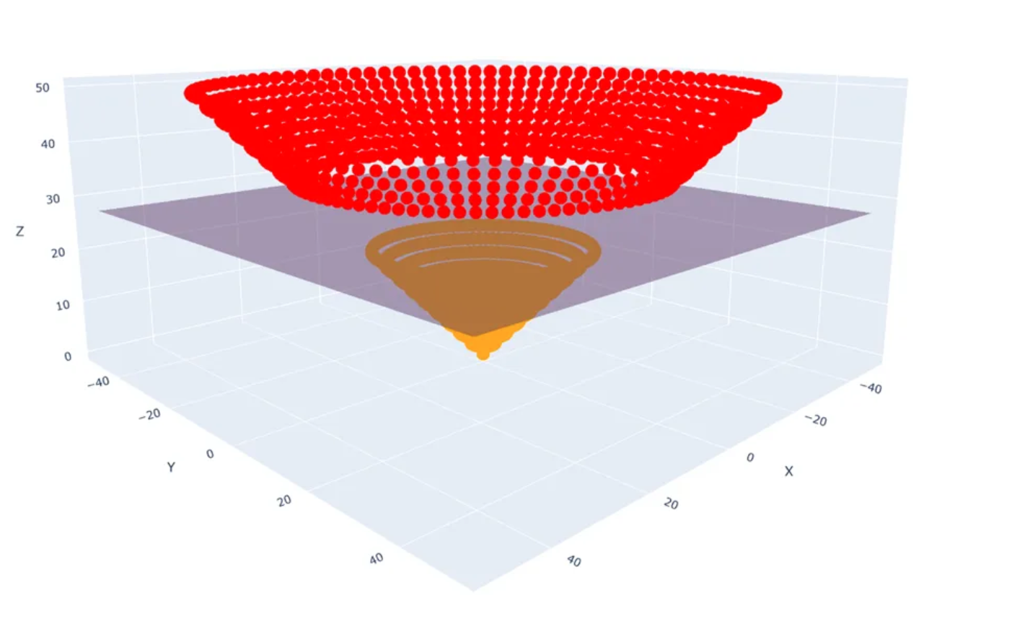
Kernel Trick

Slide 20
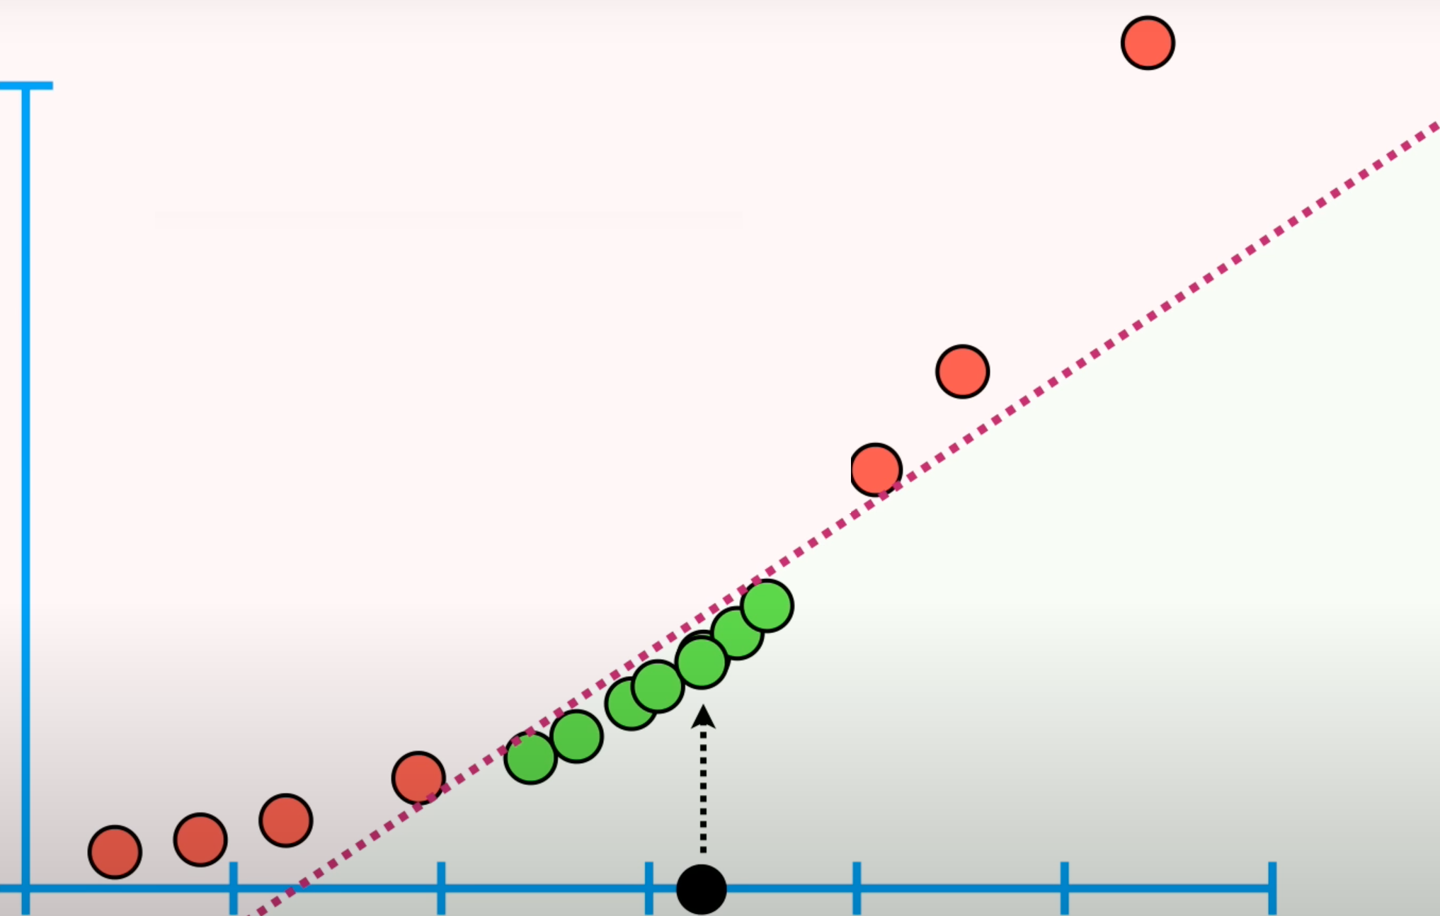

Slide 21
Kernel Trick
Different SVM algorithms used different SVM kernels:
Polynomial
Linear
Non- Linear
RBF (Radial Basis Function )
Sigmoid etc.

Slide 22
Kernel Trick
Polynomial Kernel:
This kernel is very popular in Natural Language Processing.The equation of this kernel is :
K(x_{i} , x_{j} ) = (γ(x_{i}. x_{j} )+ r)^{d} , γ > 0
Where gama is a scaling factor, r is xi xj input points and d is the degree of polynomial.

Slide 23
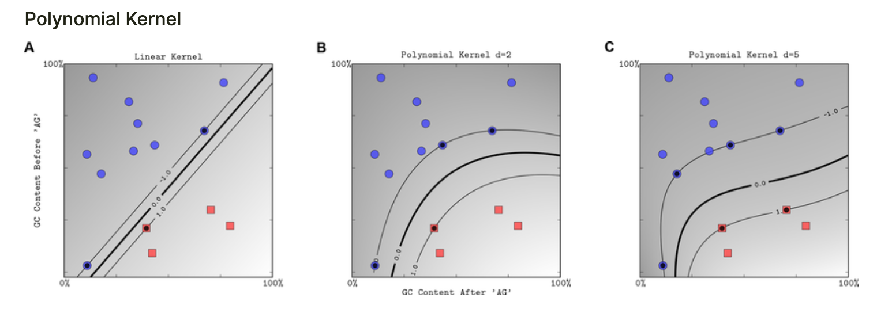

Slide 24
Regularization
Soft margin allows some misclassification errors in the training data to balance between margin maximization and classification accuracy.
The amount of tolerance for the misclassification is controlled by a parameter called the Regularization hyperparameter C, which determines how much weight should be given to minimizing classification errors versus maximizing the margin.

Slide 25
Regularization
A high value of C means the model is harder in nature (less tolerant to misclassifications).
A low value of C means that the model is softer in nature (more tolerant to misclassifications).
C controls the Bias/Variance trade-off.

Slide 26
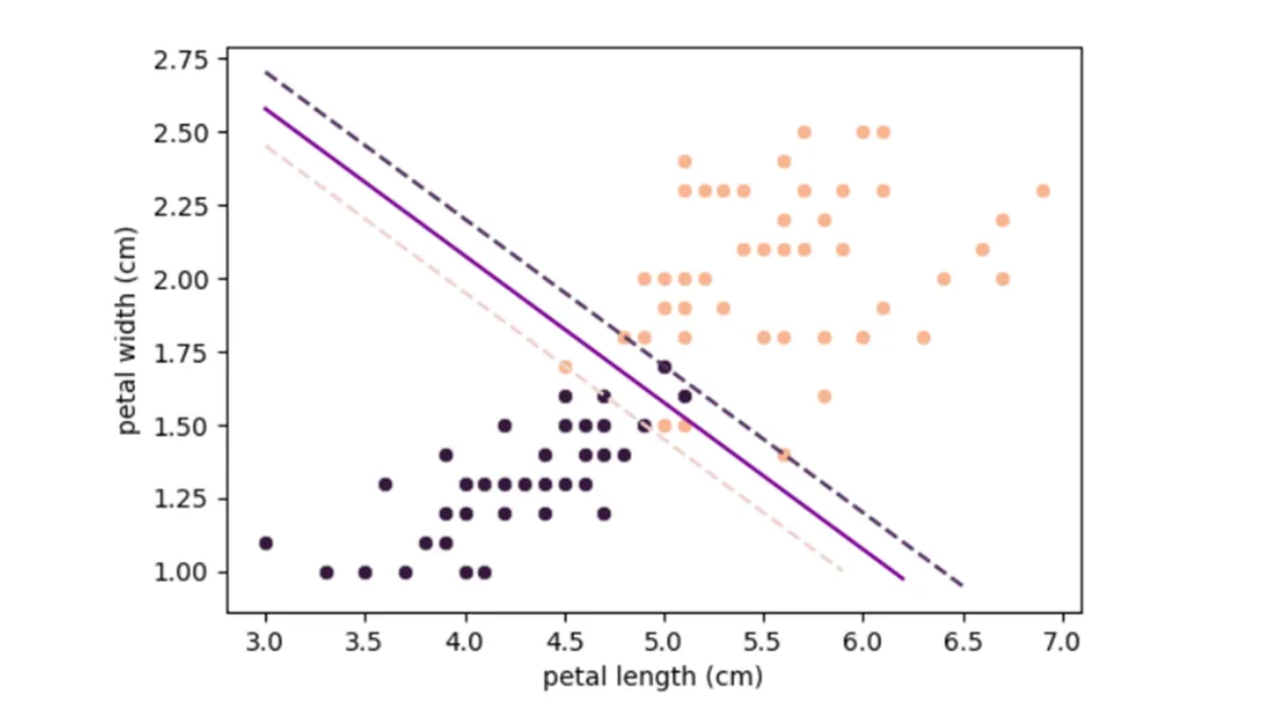
Regularization
C=100

Slide 27
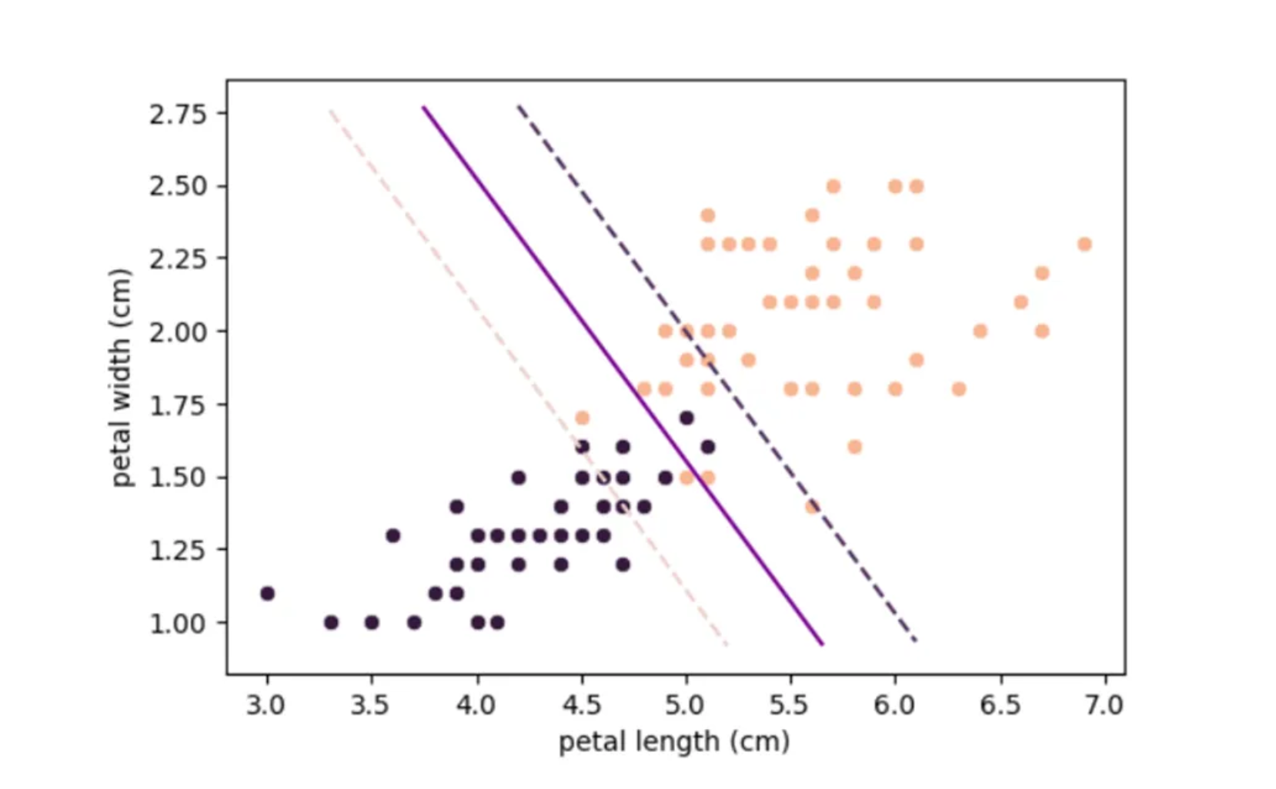
Regularization
C=1

Slide 28
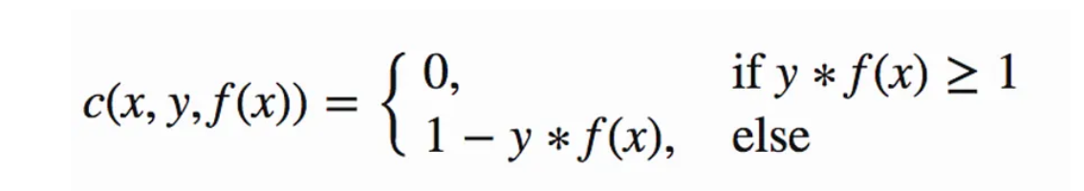
Training Process
Determining a decision boundary that best separates the classes.
We loss function tunes the parameters so that the margin is maximized:
The cost is 0 if the predicted value and the actual value are of the same sign. If they are not, we then calculate the loss value.

Slide 29
Application
Image Classification
Text Classification
Bioinformatics
Financial Forecasting
Medical Diagnosis
Marketing
Geosciences
Computer Vision

Slide 30
Pros of SVM
Effective in High Dimensions
Robust to Overfitting
Versatile Kernel Trick
Clear Margin of Separation
Memory Efficient

Slide 31
Cons of SVM
Complexity with Large Datasets: Training time can be high with large datasets, making it less suitable for very large datasets.
Choice of Kernel: Selecting the right kernel and tuning the parameters can be challenging and requires domain knowledge.
Less Effective with Noisy Data: Performance can degrade with overlapping classes and noisy data.
Interpretability: The model can be less interpretable compared to simpler algorithms like logistic regression.
Binary Classification: SVM is inherently a binary classifier.

Slide 32
Reference
https://towardsdatascience.com/support-vector-machine-introduction-to-machine-learning-algorithms-934a444fca47
https://medium.com/low-code-for-advanced-data-science/support-vector-machines-svm-an-intuitive-explanation-b084d6238106
https://www.youtube.com/watch?v=efR1C6CvhmE&t=859s

